Slide 1
3.2 Repetition Structures (Part 2)
ITP3914 – Programming
Part 3 – Basic Program Structures

Slide 2

Part 1 – Nested loop

Slide 3

Revision – Basic Loop Structure
import java.util.*;
public class WhileEg1 {
public static void main(String [ ] args) {
int i=1;
int sum=0;
while (i < 4) {
sum += i;
i++;
}
System.out.println("Sum=" + sum);
}
}
boolean condition
false
true
while (condition)
loop_body;
next_statement;
loop_body
next_statement

Slide 4
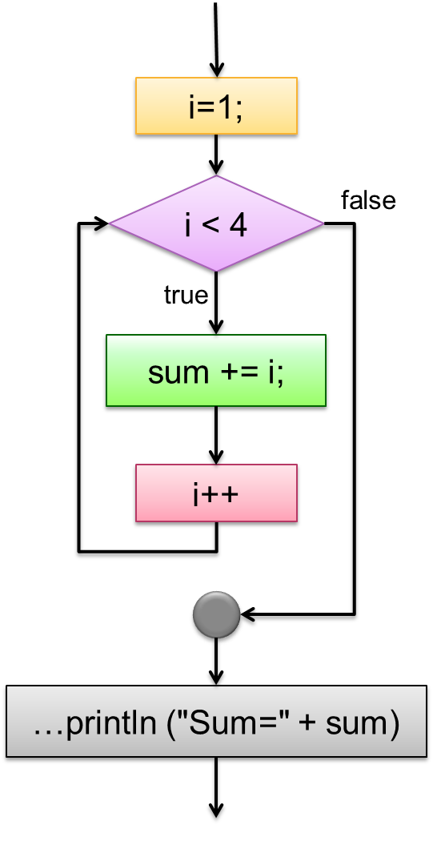
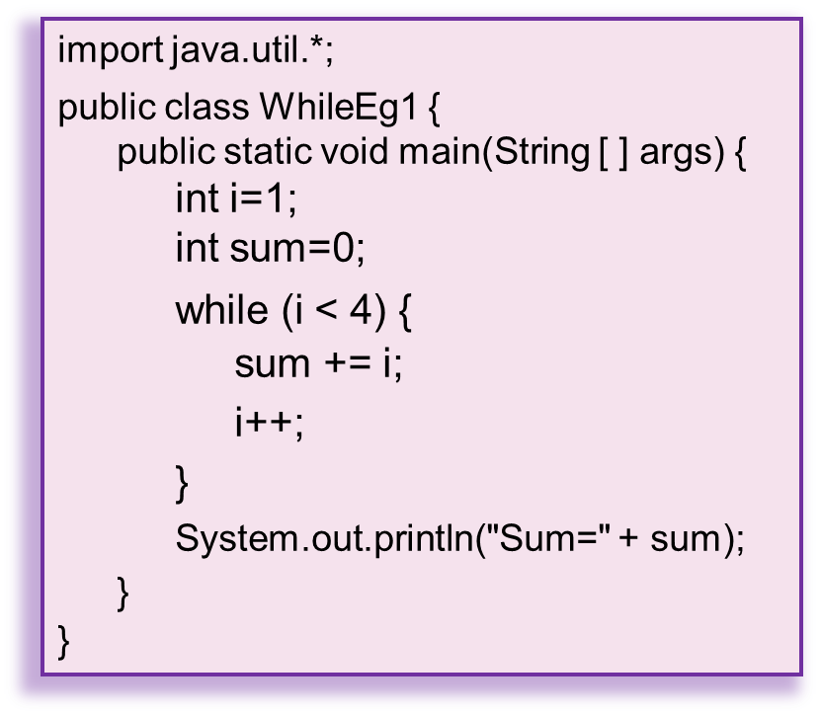
The for-loop counterpart
int sum=0;
for ( int i=1; i < 4; i++ )
sum += i;
System.out.println("Sum=" + sum);

Slide 5
import java.util.*;
public class NestedForEg1 {
public static void main(String [ ] args) {
}
}
for (int i=1; i<=3; i++) {
}
i equals 1
You don’t have to know the details of the loop body. It is executed three times anyway.
i equals 2
i equals 3

Slide 6
import java.util.*;
public class NestedForEg1 {
public static void main(String [ ] args) {
}
}
for (int i=1; i<=3; i++) {
}
System.out.println("Hello");
c:\> java NestedForEg1
c:\> java NestedForEg1
Hello
c:\> java NestedForEg1
Hello
Hello
c:\> java NestedForEg1
Hello
Hello
Hello
i equals 1
System.out.println("Hello");
i equals 2
System.out.println("Hello");
i equals 3
System.out.println("Hello");

Slide 7
import java.util.*;
public class NestedForEg2 {
public static void main(String [ ] args) {
}
}
for (int i=1; i<=3; i++) {
}
Outer Loop
for (int k=0; k<5; k++)
System.out.print("*");
System.out.println();
Inner Loop
c:\> java NestedForEg2
c:\> java NestedForEg2
*****
c:\> java NestedForEg2
*****
*****
c:\> java NestedForEg2
*****
*****
*****
i equals 1
for (int k=0; k<5; k++)
System.out.print("*");
System.out.println();
for (int k=0; k<5; k++)
System.out.print("*");
System.out.println();
for (int k=0; k<5; k++)
System.out.print("*");
System.out.println();
i equals 2
i equals 3

Slide 8
import java.util.*;
public class NestedForEg3 {
public static void main(String [ ] args) {
}
}
for (int i=1; i<=4; i++) {
}
for (int k=1; k<=i; k++)
System.out.print("*");
System.out.println();
c:\> java NestedForEg3
c:\> java NestedForEg3
*
c:\> java NestedForEg3
*
**
c:\> java NestedForEg3
*
**
***
c:\> java NestedForEg3
*
**
***
****
i equals 1
for (int k=1; k<=1; k++)
System.out.print("*");
System.out.println();
for (int k=1; k<=2; k++)
System.out.print("*");
System.out.println();
for (int k=1; k<=3; k++)
System.out.print("*");
System.out.println();
for (int k=1; k<=4; k++)
System.out.print("*");
System.out.println();
i equals 2
for (int k=1; k<=i; k++)
System.out.print("*");
System.out.println();
i equals 3
i equals 4

Slide 9
import java.util.*;
public class NestedForEg4 {
public static void main(String [ ] args) {
int size=5;
}
}
for (int i=1; i<=size; i++) {
System.out.println();
}
for (int j=1; j<=size-i; j++)
System.out.print(" ");
c:\> java NestedForEg4
*
**
***
****
*****
for (int k=1; k<=i; k++)
System.out.print("*");

Slide 10
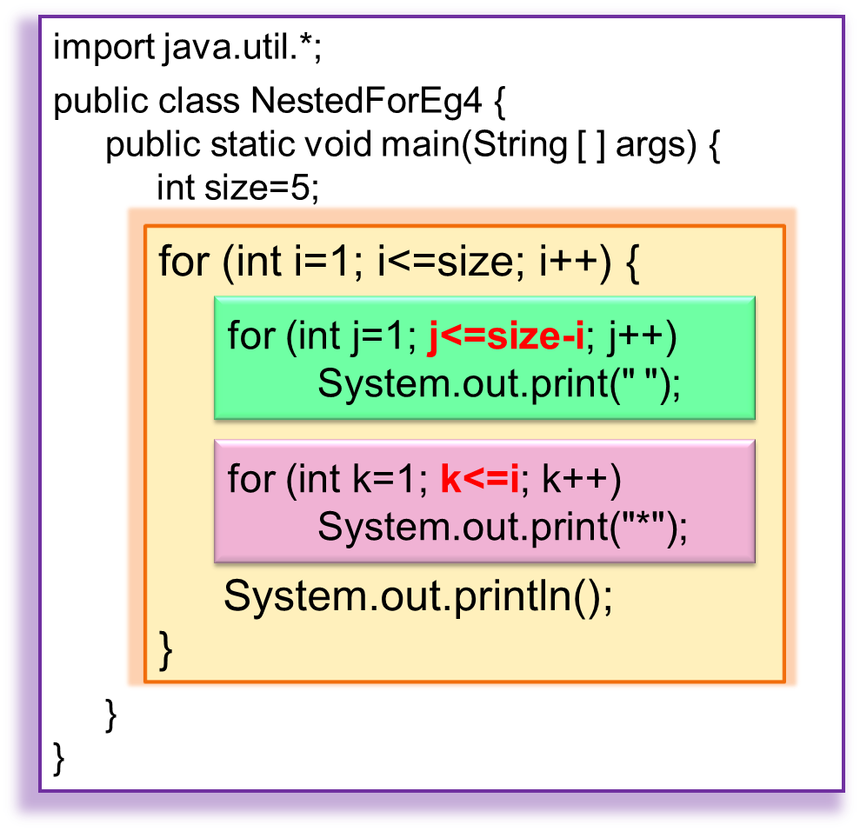
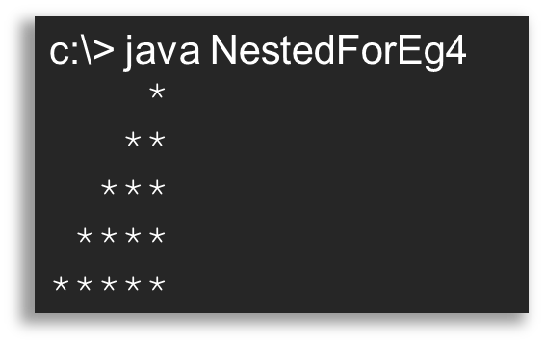
for (int j=1; j<=(5-1); j++)
i equals 1
□□□□*
for (int k=1; k<=1; k++)
for (int j=1; j<=(5-2); j++)
i equals 2
□□□**
for (int k=1; k<=2; k++)
for (int j=1; j<=(5-3); j++)
i equals 3
□□***
for (int k=1; k<=3; k++)
for (int j=1; j<=(5-4); j++)
i equals 4
□****
for (int k=1; k<=4; k++)
for (int j=1; j<=(5-5); j++)
i equals 5
*****
for (int k=1; k<=5; k++)

Slide 11
Exercise
Write a Java application that asks the user to input the size and prints a corresponding half-diamond.
size? 4
*
**
***
****
***
**
*
size? 5
*
**
***
****
*****
****
***
**
*
size? 6
*
**
***
****
*****
******
*****
****
***
**
*

Slide 12
Exercise²
Write a Java application that asks the user to input the size and prints a corresponding diamond.
size? 4
*
***
*****
*******
*****
***
*
size? 5
*
***
*****
*******
*********
*******
*****
***
*
size? 6
*
***
*****
*******
*********
***********
*********
*******
*****
***
*

Slide 13
public class FindPrime {
public static void main(String [ ] args) {
int primeCount=1;
System.out.print(2); // 2 is the first prime number
int num=2;
while (primeCount < 20) {
num++; // try next number
boolean isPrime=true;
for (int i=2; i<num; i++) {
if (num%i == 0) // divisible by i
isPrime = false; // not a prime
}
if (isPrime) {
primeCount++; // one more prime is found
System.out.print(", " + num);
}
}
System.out.println("\nDone");
}
}
A prime number is a natural number greater than 1 that has no positive divisors other than 1 and itself.
Outer loop to find prime numbers
Inner loop to check if num is prime by continuously dividing num to find a divisor
c:\> java FindPrime
2, 3, 5, 7, 11, 13, 17, 19, 23, 29, 31, 37, 41, 43, 47, 53, 59, 61, 67, 71
Done

Slide 14
import java.util.*;
public class NestedForEg5 {
public static void main(String [ ] args) {
}
}
Study the program yourself.
Scanner keyboard = new Scanner(System.in);
int n, cnt=0;
System.out.print("Value? ");
n = keyboard.nextInt();
for (int i=0; i<=n; i++)
for (int j=0; j<=n; j++)
for (int k=0; k<=n; k++)
if (i + j + k == n) {
System.out.println(i + ", " + j + ", " + k);
cnt++;
}
System.out.println("Count=" + cnt);

Slide 15
Part 2 – Further flow Control – break and continue

Slide 16
The break statement
boolean condition
false
Causes an exit from the innermost enclosing loop.
That is, terminate the loop.
true
loop_body
break;
loop_body
while (condition) {
loop_body;
…
if (…)
break;
…
}
next_statement;
next_statement

Slide 17
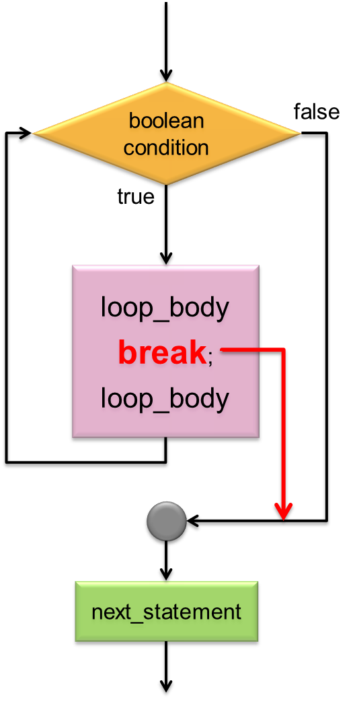
Example
import java.util.*;
public class BreakWhile {
public static void main(String [ ] args) {
Scanner kb = new Scanner(System.in);
int n;
while (true) {
n = kb.nextInt();
if (n <= 0)
break;
System.out.println("Square root of " + n + " = " + Math.sqrt(n));
}
}
}
c:\> java BreakWhile
c:\> java BreakWhile
9
c:\> java BreakWhile
9
Square root of 9 = 3.0
c:\> java BreakWhile
9
Square root of 9 = 3.0
10
c:\> java BreakWhile
9
Square root of 9 = 3.0
10
Square root of 10 = 3.1622776601683795
c:\> java BreakWhile
9
Square root of 9 = 3.0
10
Square root of 10 = 3.1622776601683795
16
c:\> java BreakWhile
9
Square root of 9 = 3.0
10
Square root of 10 = 3.1622776601683795
16
Square root of 16 = 4.0
c:\> java BreakWhile
9
Square root of 9 = 3.0
10
Square root of 10 = 3.1622776601683795
16
Square root of 16 = 4.0
0
c:\> java BreakWhile
9
Square root of 9 = 3.0
10
Square root of 10 = 3.1622776601683795
16
Square root of 16 = 4.0
0
c:\>

Slide 18
Example²
break causes immediately termination of loop;
i++ will be skipped.
import java.util.*;
public class BreakFor {
public static void main(String [ ] args) {
Scanner kb = new Scanner(System.in);
int i, x;
for (i=0; i<10; i++) {
System.out.print("i=" + i + "\tx=? ");
x = kb.nextInt();
if (x==0)
break;
}
System.out.println("i=" + i);
System.out.println("Bye");
}
}
c:\> java BreakFor
i=0 x=? 10
i=1 x=? 20
i=2 x=? 30
i=3 x=? 0
i=3
Bye
c:\>

Slide 19
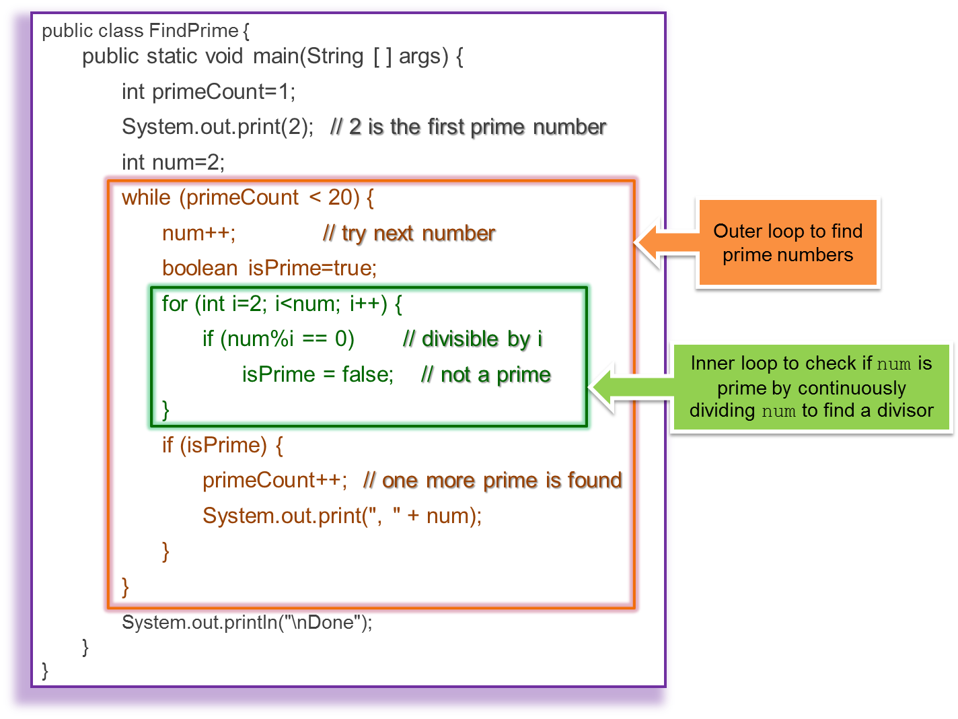
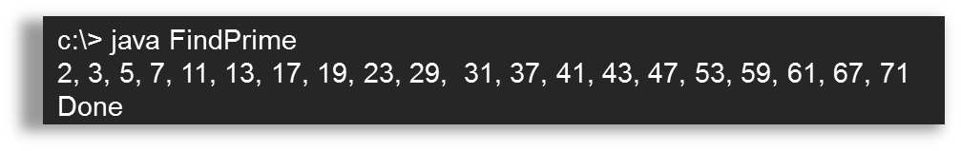
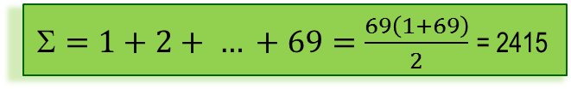
How many times num%i has been executed altogether for searching the 20 primes?
num
3
3%2 → 1 time
num
4
4%2, 4%3 → 2 times
num
5
5%2, 5%3, 5%4 → 3 times
num
6
6%2, 6%3, 6%4, 6%5 → 4 times
Can you think of a way to improve the efficiency?
num
7
7%2, 7%3, 7%4, 7%5, 7%6 → 5 times
num
8
8%2, 8%3, 8%4, 8%5, 8%6, 8%7 → 6 times
…
You will study program efficiency in ITP4510.
num
71
71%2, 71%3, 71%4, 71%5, 71%6, …, 71%70 → 69 times
$=1+2+ … +69=\frac{69\left(1+69\right)}{2}$= 2415

Slide 20
Labeled break (optional/self-study)
The labeled break statement allows you to break an outer loop.
import java.util.*;
public class LabelBreak {
public static void main(String [ ] args) {
stop: // label
for (int row=1; row<=10; row++) {
for (int column=1; column<=5; column++) {
if (row == 5)
break stop;
System.out.print("*");
}
System.out.println();
}
}
}

Slide 21
The continue statement
boolean condition
false
Causes the current iteration of a loop to stop and begins the next iteration.
The remaining statements in the loop are bypassed.
true
loop_body
continue;
loop_body
while (condition) {
loop_body;
…
if (…)
continue;
…
}
next_statement;
next_statement

Slide 22
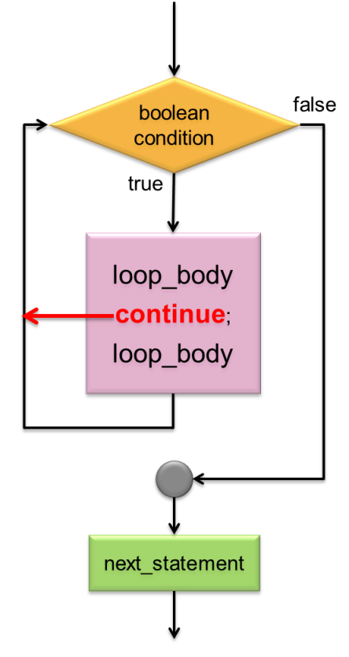
Example
public static void main(String [ ] args) {
Scanner kb = new Scanner(System.in);
int x, sum=0;
for (int i=0; i<5; i++) {
System.out.print("x=? ");
x = kb.nextInt();
if (x <= 0)
continue;
sum += x;
}
System.out.println("Sum = " + sum);
}
sum
0
10
30
c:\> java ContinueEg
c:\> java ContinueEg
x=?
c:\> java ContinueEg
x=? 10
c:\> java ContinueEg
x=? 10
x=?
c:\> java ContinueEg
x=? 10
x=? 20
c:\> java ContinueEg
x=? 10
x=? 20
x=?
c:\> java ContinueEg
x=? 10
x=? 20
x=? -1
c:\> java ContinueEg
x=? 10
x=? 20
x=? -1
x=?
c:\> java ContinueEg
x=? 10
x=? 20
x=? -1
x=? 90
c:\> java ContinueEg
x=? 10
x=? 20
x=? -1
x=? 90
x=?
c:\> java ContinueEg
x=? 10
x=? 20
x=? -1
x=? 90
x=? -5
c:\> java ContinueEg
x=? 10
x=? 20
x=? -1
x=? 90
x=? -5
Sum = 120
120

Slide 23
Labeled continue (optional/self-study)
The labeled continue statement allows you to proceed directly to the next iteration of a specified outer loop.
import java.util.*;
public class LabelContinue {
public static void main(String [ ] args) {
nextRow:
for (int row=1; row<=5; row++) {
System.out.println();
for (int column=1; column<=10; column++) {
if (column > row)
continue nextRow;
System.out.print("*");
}
}
}
}

Slide 24
Example
public class MarkSix {
public static void main(String [ ] args) {
final int MAXNUM=49;
int num, lastValue, count=0;
String result;
tryAgain:
while (true) {
count++;
System.out.print(“\nTrial " + count + ": ");
result="";
lastValue=0;
for (int i=1; i<=6; i++) {
num = 1 + (int) (Math.random() * MAXNUM);
while (num <= lastValue) {
num = 1 + (int) (Math.random() * MAXNUM);
}
if (num==MAXNUM && i<6)
continue tryAgain;
else {
System.out.print(num + " ");
lastValue = num;
}
}
break tryAgain;
}
System.out.println(result);
}
}
Study the program yourself.
c:\> java MarkSix
Trial 1: 15 19 44 48
Trial 2: 47 48
Trial 3: 42 43
Trial 4: 11 28 35 36 41 48

Slide 25
END

